Slide 1



Keeping Integration Sane with NServiceBus
Jimmy Bogard
jimmybogard.lostechies.com
@jbogard

Slide 2
Why do we integrate?

Slide 3
How do we integrate?

Slide 4
NServiceBus Primer (in 30 seconds)

Slide 5
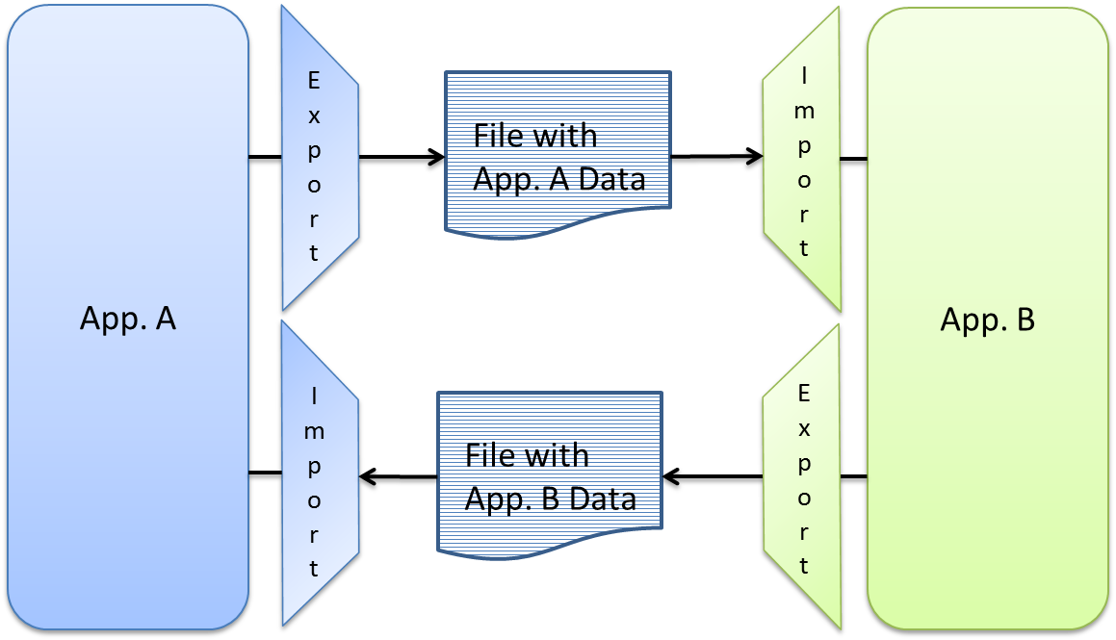
Files

Slide 6


Consuming Files
Data
Importer
Deadlock
DB
Rollback
What made it through?

Slide 7

Consuming Files
Data
Parser
Process File
Process Line
Commit
Commit
Processor
DB

Slide 8
Demo

Slide 9
Producing Files
Id | Name | Changed
1 | Walter | Y
2 | Cora | N
3 | Alejandro | N
4 | Carlton | Y
5 | Janice | N
Id | Name | Changed
1 | Walter | Y
2 | Cora | N
3 | Alejandro | N
4 | Carlton | Y
5 | Janice | N
Id | Name | Changed
1 | Walter | Y
2 | Kiera | Y
3 | Alejandro | N
4 | Carlton | Y
5 | Janice | N
Exporter
File
SELECT Name
WHERE Changed = ‘Y’
UPDATE People
SET Changed = ‘N’
We’re missing a change

Slide 10
Producing Files
Id | Name | BatchId
1 | Walter | NULL
2 | Cora | 1
3 | Alejandro | 1
4 | Carlton | NULL
5 | Janice | 2
Id | Name | BatchId
1 | Walter | 3
2 | Cora | 1
3 | Alejandro | 1
4 | Carlton | 3
5 | Janice | 2
Id | Name | BatchId
1 | Walter | 3
2 | Kiera | NULL
3 | Alejandro | 1
4 | Carlton | 3
5 | Janice | 2
Exporter
File
UPDATE People
SET BatchId = 3
WHERE BatchId IS NULL
SELECT Id, Name
FROM People
WHERE BatchId = 3
Mark records to export
Export marked records

Slide 11
Demo

Slide 12
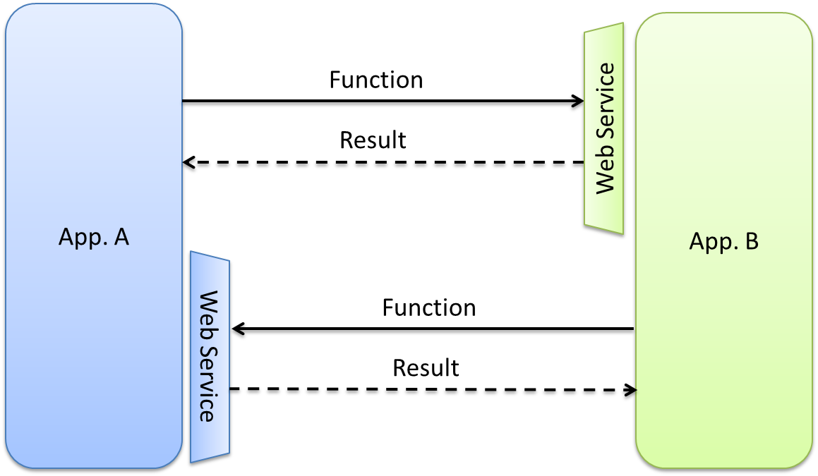
Web Services

Slide 13
Invoking web services from handlers
Rollback
$$ Order
H1
H2
H3
H4
Not Rolled back
[HTTP] Invoke
DB
WS
Deadlock

Slide 14
Integrating messaging & WS
The right way
The message won’t be sent if there’s a failure
$$ Order
Msg
H1
H2
H3
H4
DB
[HTTP] Invoke
WS
Messaging
Gateway
Commit

Slide 15
Demo

